Slide 1
GO Team Meeting #2
Where we are – Where we’re going

Slide 2

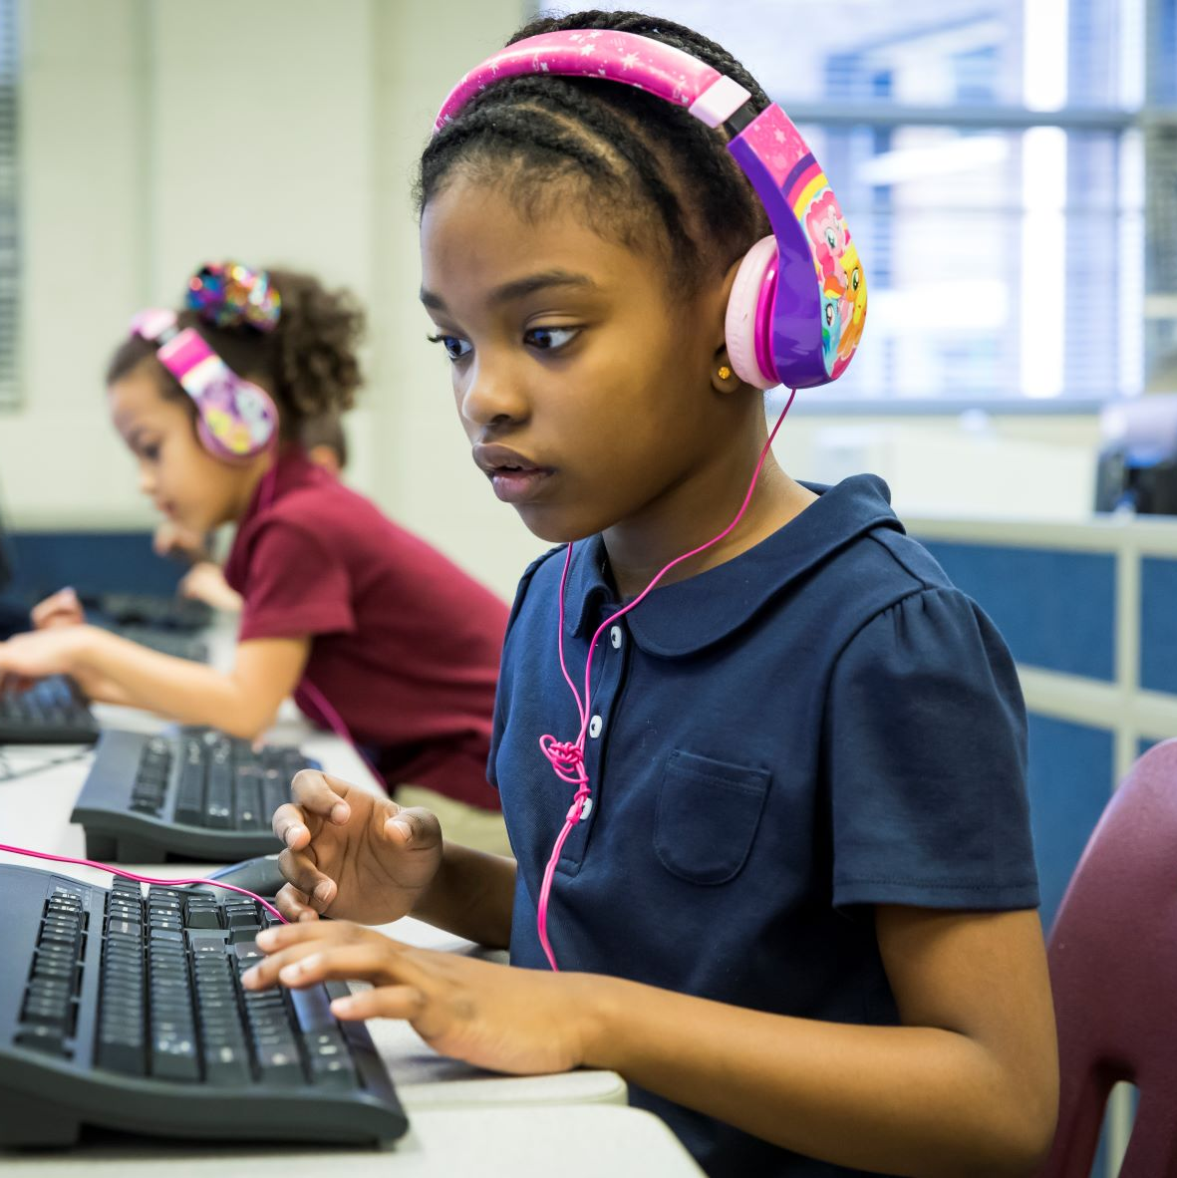
Where We Are
Our strategic plan is the guide for the work we’re doing in the school. By monitoring the plan and ranking priorities, we can all work towards the common goals. Using the priorities in the strategic plan, the school leadership team developed a Continuous Improvement Plan (CIP) for the current school year.

Slide 3
Timeline for GO Teams
You are HERE
Fall 2021
GO Team Developed 2021-2025 Strategic Plan
1
Summer 2022
School Leadership completed Needs Assessment and defined overarching needs for SY22-23
2
August 2022
School Leadership completed 2022-2023 Continuous Improvement Plan
3
Sept. – Dec. 2022
Utilizing current data, the GO Team will review & possibly update the school strategic priorities and plan
4
Before Winter Break
GO Team will take action (vote) on the rank of the strategic plan priorities for SY23-24 in preparation for budget discussions.
5

Slide 4
Discussion Items
Current Strategic Plan
Continuous Improvement Plan
Needs Assessment
SMART GOALS
Monitoring Measures
MAP Data
Data Protocol

Slide 5
Current
Strategic Plan
2021-2025

Slide 6
Mission
West Manor IB World School
Vision
SMART Goals
Increase the % of grades 3-5 students scoring proficient or above on Milestones/ MAP in reading by 3%
Increase the % of grades 3-5 students scoring proficient or above on Milestones/MAP in math by 3%
Increase the percentage of students with 10 or less absences by 3%
APS Strategic Priorities & Initiatives
School Strategic Priorities
School Strategies
Fostering Academic Excellence for All
Data
Curriculum & Instruction
Signature Program
1.
3.
1A. Implementation of an intervention block to reduce gaps in learning
1B. Employ a literacy block with phonics for grades k-2
1C. Create PLC planning time for teachers to internalize standards and plan for instruction
Increase student phonic awareness and create early readers
Increase student knowledge in numbers and operations domain
Increase student multiplication skills
Building a Culture of Student Support
Whole Child & Intervention
Personalized Learning
Increase student attendance and decrease suspension rate
TBD: Create an attendance team to monitor and address attendance concerns, Create a Care Team to address student needs
TBD: Utilize SLC practices and restorative justice with the Counselor to reduce suspensions
Equipping & Empowering Leaders & Staff
Strategic Staff Support
Equitable Resource Allocation
Increasing Teacher knowledge of Standards
Increase Teacher knowledge of IB Program
TBD: Monthly IB training for staff, Professional development individualized around teacher needs in reading and math, training for phonics program (Fundations)
Ongoing PD for SEL, restorative practices, and trauma
Creating a System of School Support
Collective Action, Engagement & Empowerment
TBD: Conduct data meetings in PLC, with parents and students. Students will also have goal setting meetings with teachers
--Increase Parent Liaison and Social Worker positions to full time to support the needs of students and parents
Improve stakeholder knowledge of school data and how to assist
Provide support to students and stakeholders in need

Slide 7
Continuous Improvement Plan
SY 2022-2023

Slide 8
West Manor IB World School
Needs Assessment
Our Overarching Needs
Literacy Proficiency | Numeracy Proficiency | Whole Child/ Student Support
Why?
Literacy is needed for comprehension across all content areas and is the key for college and Career readiness
Teacher's need deep knowledge of phonics & phonemic awareness instruction
Emphasis on intervention and basic skills. Instruction should cover the depth of the standard is needed
During collaborative planning teachers should internalize the standard and model lessons
. A combination of phonological awareness, phonics, and high frequency words prevent students success as early readers
Why?
Why?
Why?
Need for more support of implementation of consistent, intentional differentiated instruction
Students struggle in Numbers in Base 10 and Numbers in Operation in Fractions which hold the highest weights
Students struggle with multiplication skills
During collaborative planning there needs to be specific action planned for remediation and acceleration
Why?
Why?
Why?
Children have experienced trauma during the Covid pandemic
Parent participation has dropped over time due to unknown causes
We need to increase Parent Liaison position to full time
Create a Care Team with wrap around support for parents and students
Increase parent participation through IB/ Parent Data meeting
Why?
Why?
Root Cause
Students need a foundation in phonics to become strong readers | Students need more practice in the operation domain and practice with manipulatives | If parent needs are not met it will lead to increased absenteeism and possible disciplinary concerns

Slide 9
West Manor Elementary
Goals
Our Overarching Needs
Increase student knowledge of phonics and phonemic awareness to support early readers | Increase student proficiency in the Numbers and Operations domain | reaffirm the relationship of partnership between the school and parents to assist scholars
SMART Goals (Elementary/Middle School)
Increase the % of grades 3-8 students scoring proficient or above on Milestones in reading by 3% | Increase the % of grades 3-8 students scoring proficient or above on milestones in math by 3% | Increase the percentage of students with 10 or less absences by 3% Decrease the number of out of school suspensions by 3%
Progress Monitoring Measures
MAP assessment given three times during the school year Monthly grade level common assessments followed by data meetings Quarterly benchmark assessments at the end of each unit Monitoring of growth through intervention with RTI Specialist | MAP assessment given three times during the school year Monthly grade level common assessments followed by data meetings Quarterly benchmark assessments at the end of each unit Monitoring of growth through intervention with RTI Specialist | Weekly meetings with attendance team to monitor trends Social worker referrals for students reaching 5 absences during semester 1

Slide 10
Our Current
Progress Monitoring Measures
Literacy
Numeracy
Whole Child
Implementation of intervention block from 9am to 9:45 4 times a week
Mandatory phonics block for k-2
Employ a PLC process that requires teachers to model lessons and present what students are to know and do in order to reach a level of mastery regarding the standard
Creation of Attendance/ Care Team to identify and address needs of students

Slide 11
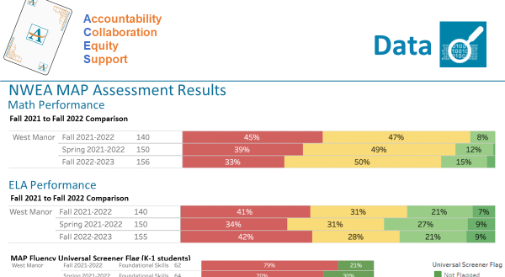
MAPS Data
1st Administration

Slide 12

GO Team Discussion:
Data Protocol
What do you notice?
What are your wonderings?
What additional questions do you have?

Slide 13
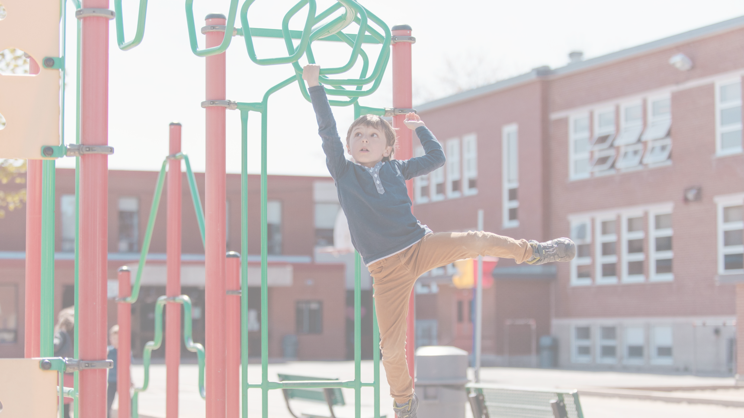
Strategic planning will help you fully uncover your available options, set priorities for them, and define the methods to achieve them.
Robert J. Mckain

Slide 14
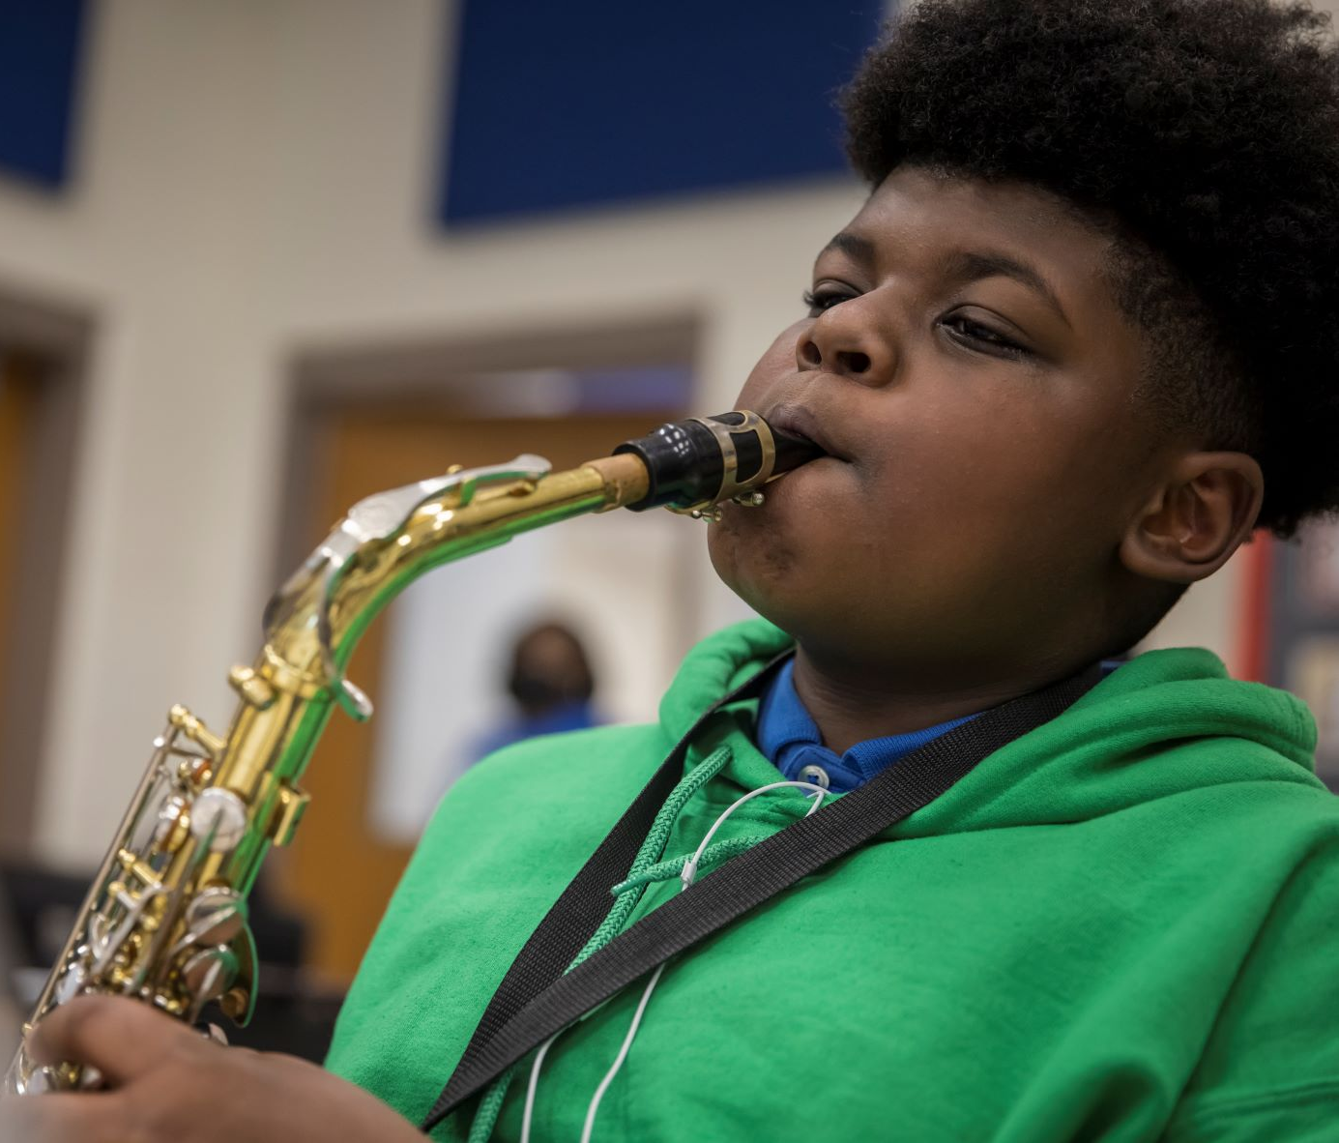

Where we’re going
At our next meeting(s) we will discuss how our data is aligning to our strategic plan and determine if we need to make any adjustments.
Before the end of Fall Semester, we will take Action (vote) on ranking our strategic priorities for the 2023-2024 school year.
Let me or the Chair know of any additional information you need for our future discussion.

Slide 15
Thank you

